Slide 1

PROJECT ON ANALYTICS
Created By Parag Bhati
Data Analytics

Slide 2



Name – PARAG BHATI COUSRE – B.TECH BRANCH - (CSE) YEAR – 4TH COLLAGE - AIMT

Slide 3
Problem Statement
Nitin works as a Graphic Designer in a new company. He earns Rs 15,000/- per month. He is planning to buy a scooter for his daily commute to the office.
For the last couple of months, Nitin is not able to save at all for his scooter. His friend Ayush told him that he needed to figure out where most of the money goes and cut down that expense.
Help Nitin increase his savings by removing some unnecessary expenses.

Slide 4
Project 1 - Part 1 - Tasks Part 1 - Task Responsibilities
Member 1
How much is spent for each category (Pivot Table)
Visually represent the amount spent against each category is what percentage of the total expense amount
(Pivot Chart)
Member 2
How much is spent on different items of each category (Pivot Table)
Visually represent the amount spent on different items of Entertainment and Tickets and bills category
(Pivot Chart)
mber 3
How many times money has been spent against different items of each category (Pivot Table)
Filter the data to display the data for Grocery items and Shopping items
mber 4
What amount is spent on each item of the categories with highest and 2nd highest expense amount (Pivot Table)
Visually represent the data with data bars (Conditional formatting)

Slide 5
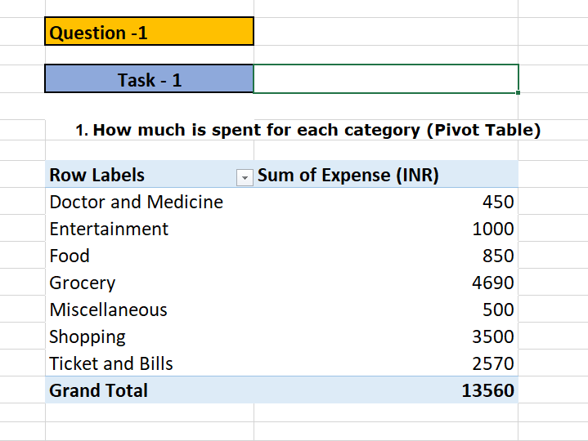
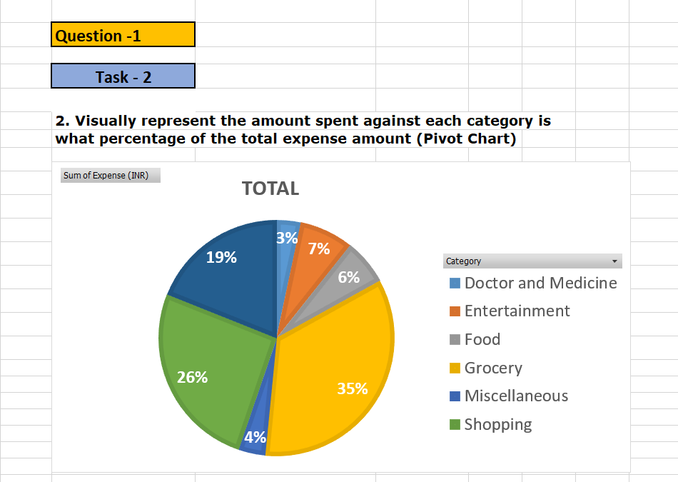
Question – 1- Task – 1 & 2

Slide 6
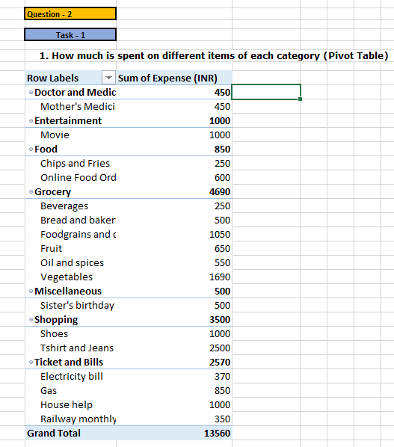
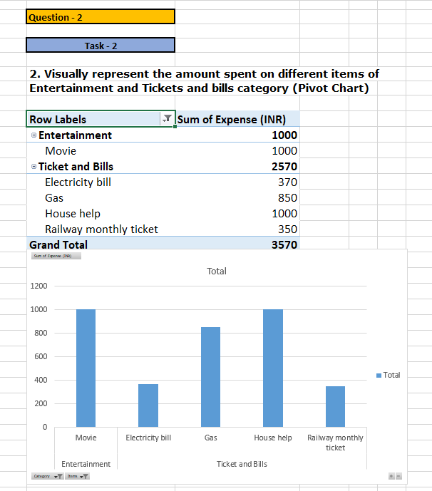
Question – 2 - Task – 1 & 2

Slide 7
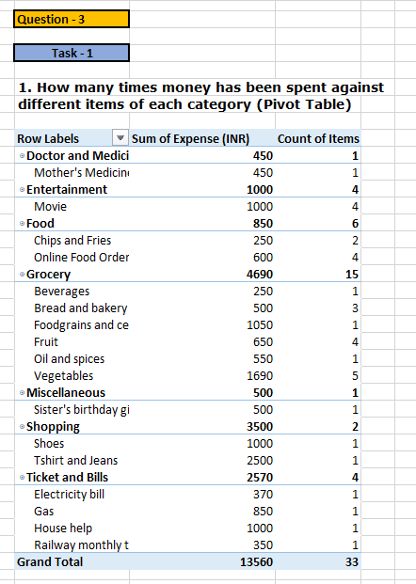
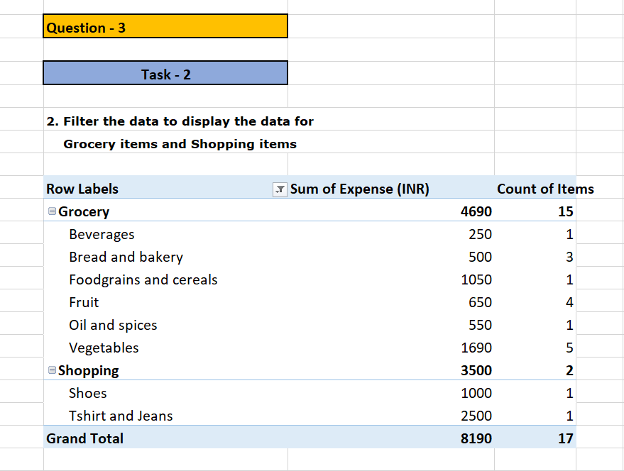
Question – 3- Task – 1 & 2

Slide 8
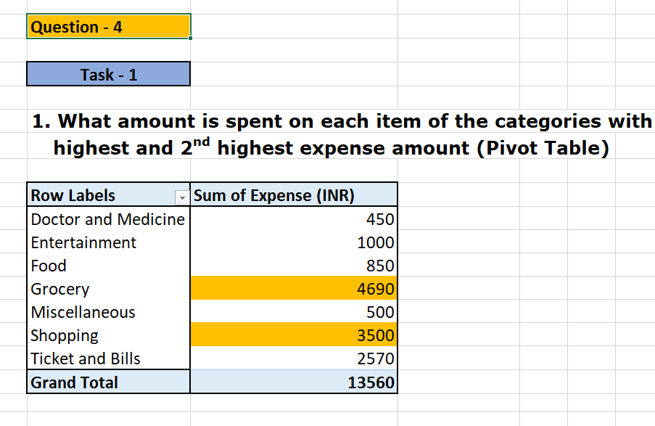
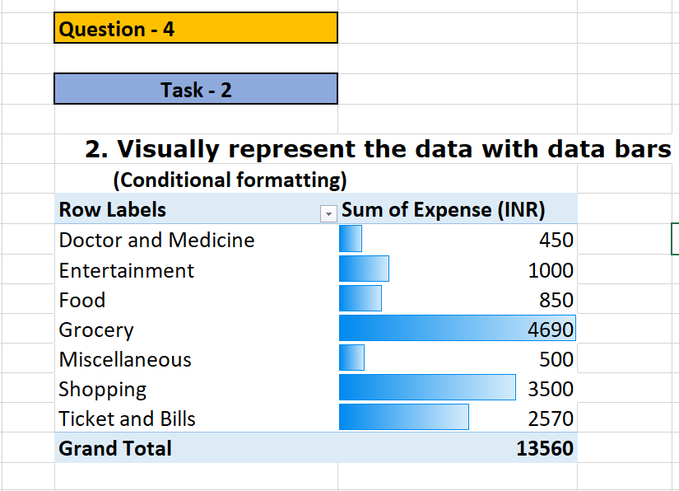
Question – 4 - Task – 1 & 2

Slide 9
Project 1 - Part 2 – Tasks Part 1 - Task Responsibilities
Month-wise trend of expenses (Pivot table and chart)
Find out the month Nitin spent the most
Category wise expenses (Pivot table)
Visually represent it with data bars to display categories with the highest and
lowest expense amount
Month-wise expense of each category (Pivot table)
Find out 2 categories with higher expenses for each of the 6 months
How much is spent in each month against different items of Entertainment, Food
and Shopping categories (Pivot table)
Find out which months have the highest amount spent for movies and dining out
Decide on the essential and less essential items and analyse the expenses
Recommend how can Nitin increase his savings

Slide 10
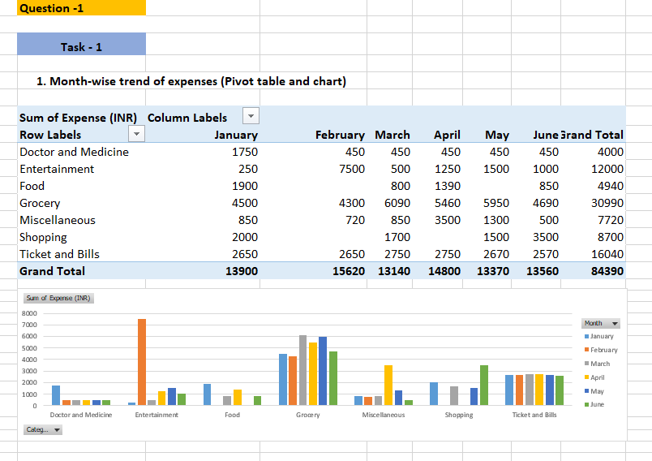
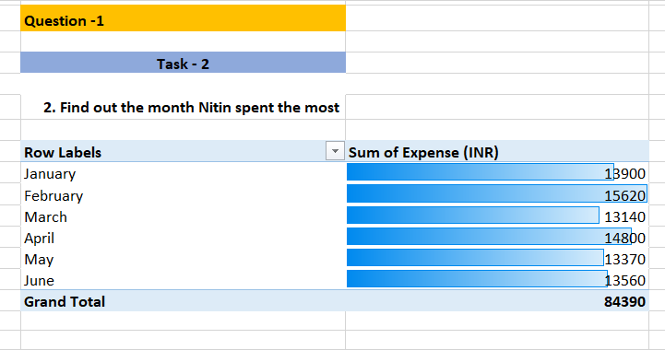
Question – 1- Task – 1 & 2

Slide 11
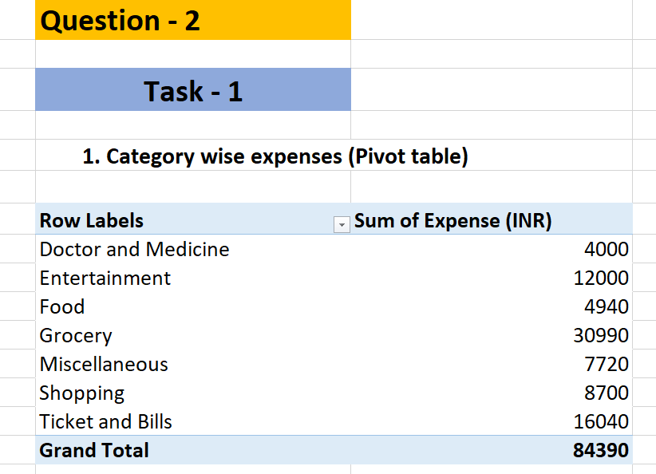
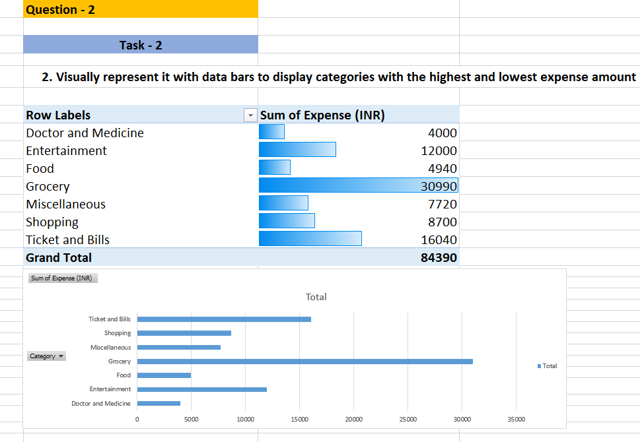
Question – 2- Task – 1 & 2

Slide 12
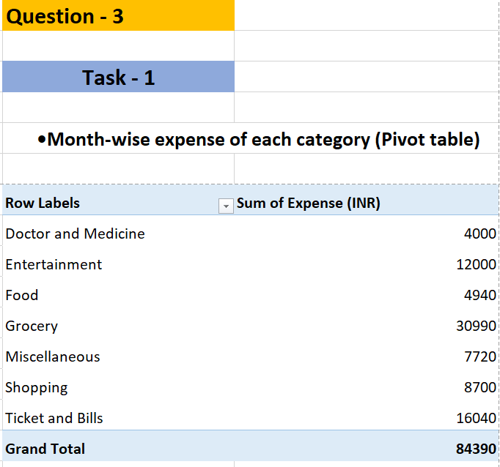
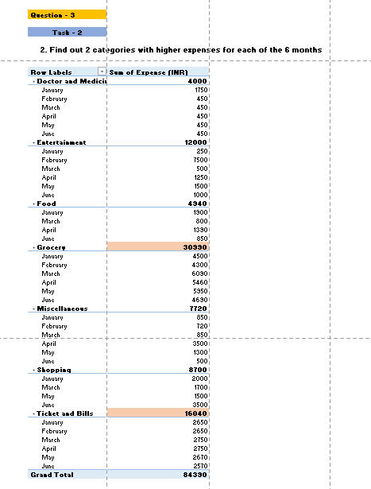
Question – 3- Task – 1 & 2

Slide 13
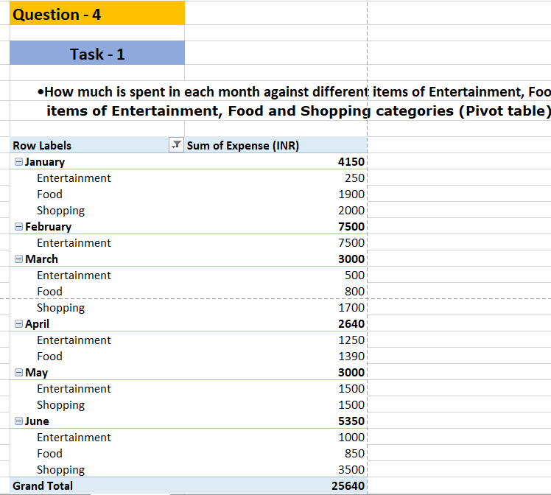
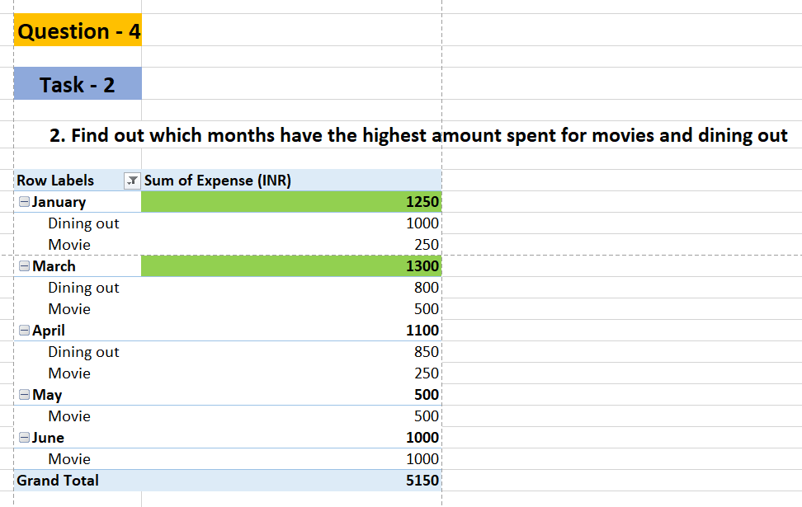
Question – 4- Task – 1 & 2

Slide 14
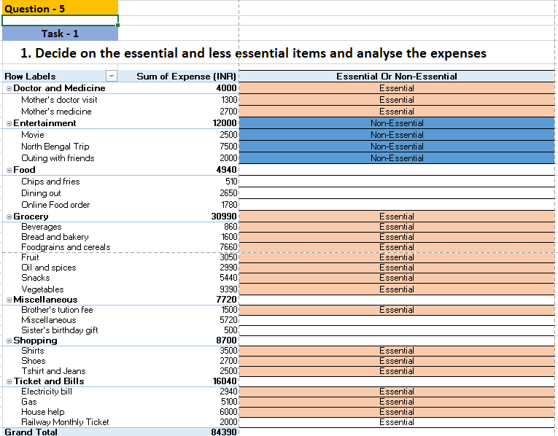
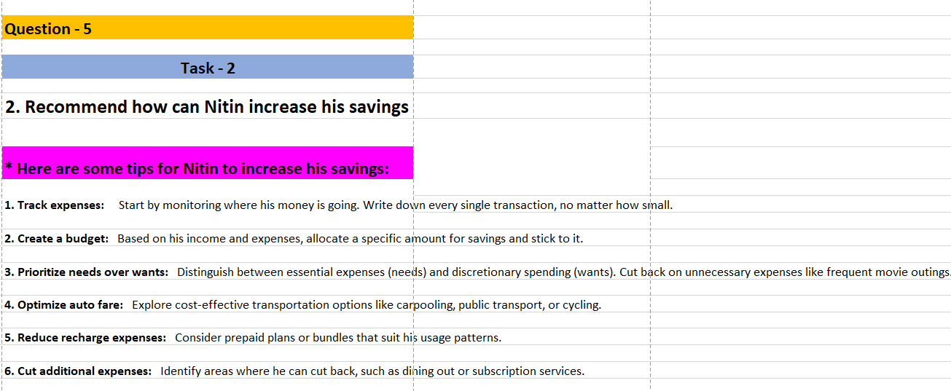
Question – 5- Task – 1 & 2

Slide 15











Thank You

